Slide 1
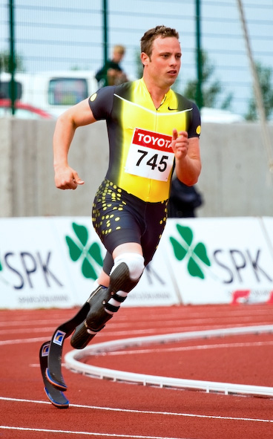
Oscar Pistorius ruled out in 2008 Olympics due to unfair advantage

Slide 2
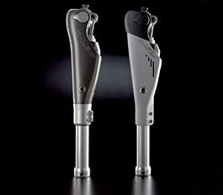
C-Leg prosthesis

Slide 3
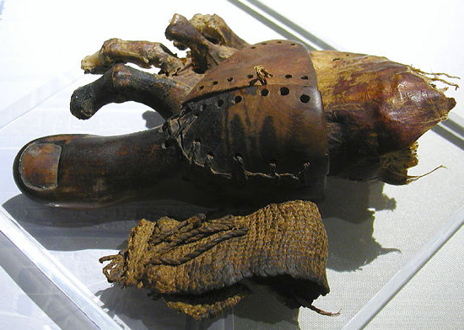
Prosthetic toe from ancient egypt

Slide 4
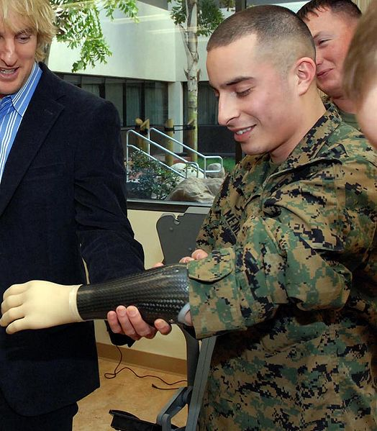
Myoelectric prosthesis in miltary

Slide 5
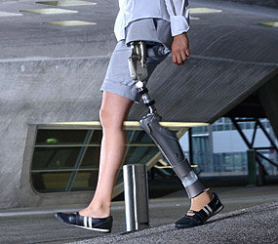
Upper limb prosthesis

Slide 6
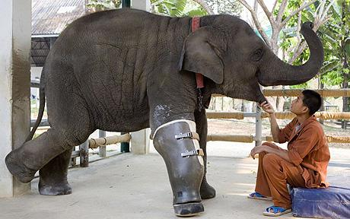
Mosha the elephant gets prosthetic leg

